Slide 1


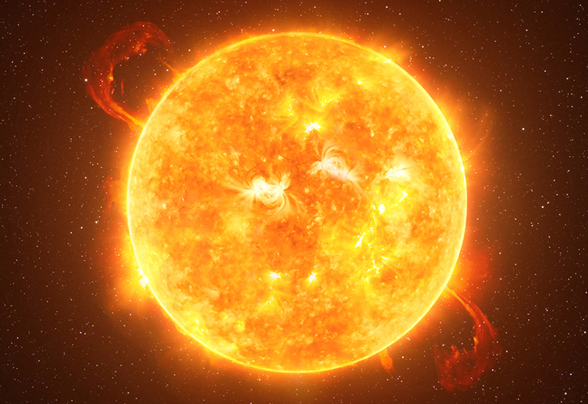
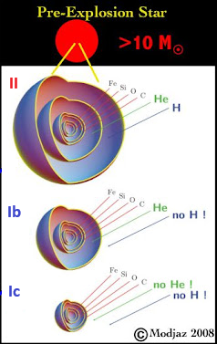
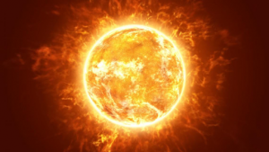
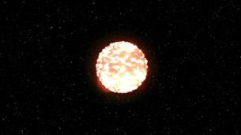
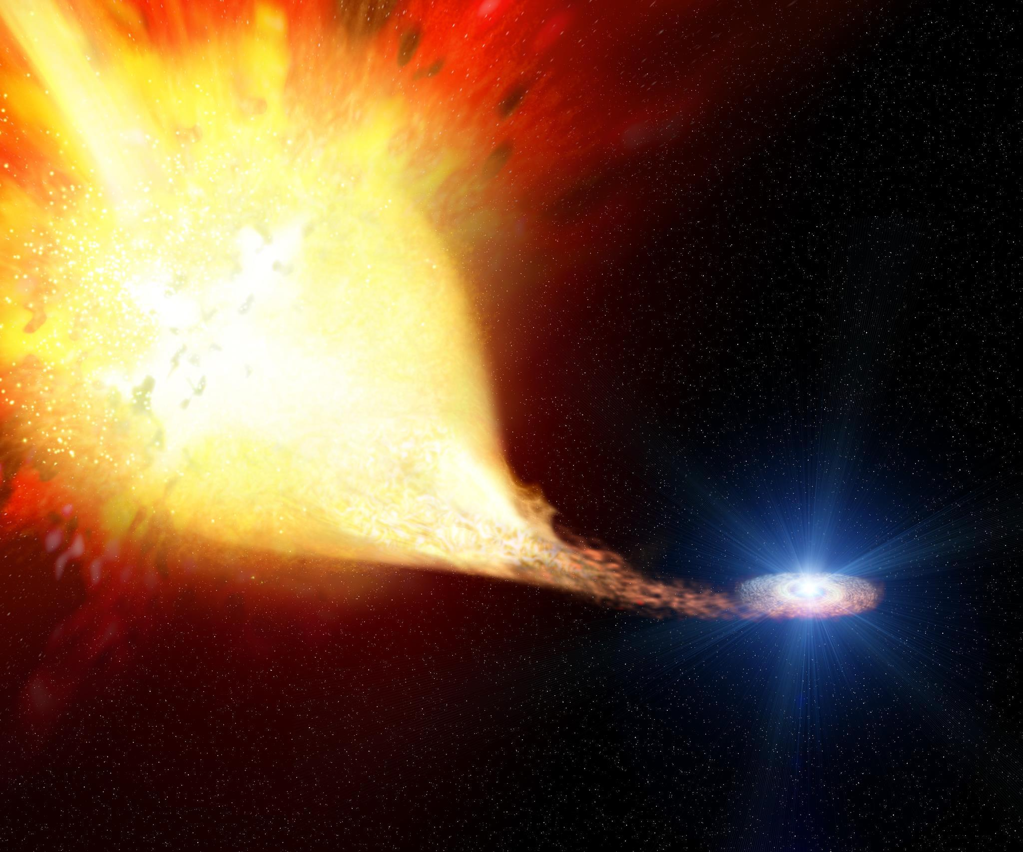

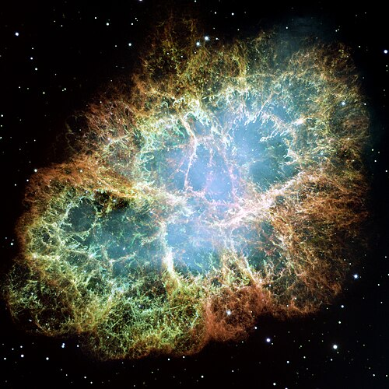
Core-Collapse Supernovae and Their Host Galaxies
D. Baghdasaryan^{1,2}, A. Hakobyan¹, A. Karapetyan¹, L. Barkhudaryan¹, M. Gevorgyan¹
¹Alikhanyan National Laboratory
²Yerevan State University
SN Types
Envelope Stripping Mechanisms
Stellar Winds
Binary Interaction
Results:
Ib+Ic VS IIP p-value < 0.05

